Slide 1



PRESENTATION
TOPIC : BISECTION METHOD
Course Code: CSE 2205
Course Title: Numerical Methods
Presented by:
Abdullah Atif
ID : 241311051
SECTION : B
4TH SEMESTER

Slide 2
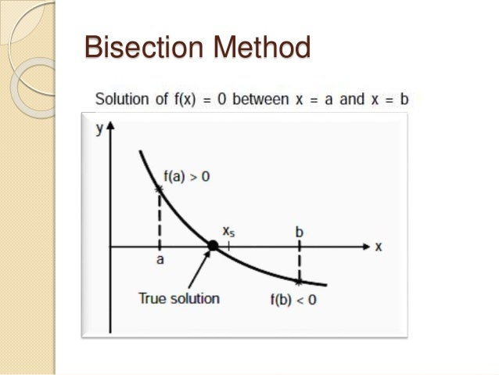
What is Bisection Method?
The bisection method is a numerical technique used to find an approximate root (zero) of a continuous function within a specified interval where the function changes sign (i.e., the function values at the interval's endpoints have opposite signs). The method works by repeatedly dividing the interval in half, checking which subinterval contains the root, and narrowing down the range until the desired accuracy is reached.

Slide 3


Why the Bisection Method matters:
Key Benefits and Learning Goals
Root finding is vital in science and engineering for solving real-world equation models
Bisection method offers simple implementation and clear understanding
Ensures reliable convergence when initial conditions are satisfied

Slide 4
Precise Iterations of the Bisection Algorithm
-Identify Initial Interval-
Select a, b where f(a) and f(b) have opposite signs (f(a)*f(b) < 0), ensuring a root lies within.
1
-Compute Midpoint-
Calculate c = (a + b) / 2 as the candidate root to test.
2
-Evaluate Function at Midpoint-
Determine f(c) to check the sign and proximity to zero.
3
-Select Subinterval-
If f(a)*f(c) < 0, root lies in a, c; otherwise, it lies in c, b.
4
-Iterate Until Convergence-
Repeat midpoint calculation and interval narrowing until the interval is sufficiently small or f(c) is near zero, achieving desired accuracy.
5

Slide 5
Stepwise Bisection Method:
Solving f(x) = x³ + 4x² - 1
Iterations | a | b | f(a) | f(b) | c | f(c)
1 | 0 | 1 | -1 | 4 | 0.5 | 0.125
2 | 0 | 0.5 | -1 | 0.125 | 0.25 | -0.73438
3 | 0.25 | 0.5 | -0.73438 | 0.125 | 0.375 | -0.38477
... | ... | ... | ... | ... | ... | ...
7 | 0.46875 | 0.484375 | -0.018097 | 0.05212 | 0.476563 | 0.01668

Slide 6

FROM THE TABLE
The interval progressively narrows, converging on the root near 0.472834
Signs of f(c) at midpoints guide interval updates to maintain root bracketing

Slide 7

ADVANTAGES OF THE BISECTION METHOD
Despite its relatively slow speed compared to advanced methods, the Bisection Method remains a fundamental tool due to its intrinsic reliability. e.g.
UNCONDITIONAL ROBUSTNESS
Convergence is guaranteed as long as the initial interval brackets a root. It is highly stable and cannot diverge.
COMPUTATIONAL SIMPLICITY
THe method only requires function evaluations and simple arithmetic (addition and division), making it easy to implement.
PREDICTABLE ERROR
THE ERRor bound is known precisely before the iterations begin, allowing one to pre-calculate the necessary number of steps for a desired accuracy.

Slide 8
LIMITATIONS OF THE BISECTION METHOD
While reliable, the Bisection Method has drawbacks that make other techniques preferable when speed and specific root types are required. e.g.
SLOW CONVERGENCE
THe linear rate of convergence means it takes many iterations to achieve high precision, especially compared to quadratic methods like Newton-Raphson.
PREREQUISITE CONSTRAINTS
It requires that the function must be continuous and that the initial interval must satisfy the sign change condition (f(a) \cdot f(b) < 0).
INABILITY TO FIND EVEN-MULTIPLICITY ROOTS
If a root has even multiplicity (the function only touches the x-axis and doesn't cross), there is no sign change, and the method cannot be applied.

Slide 9
THANK
YOU
reallygreatsite.com

